Slide 1
Focus on Pharmacology:
Essentials for Health Professionals
Third Edition
Chapter 36
Drugs Used to Treat Musculoskeletal Conditions

Slide 2
Introduction
Disorders of this system are very common in all ages:
  Osteoarthritis
  Muscle spasms
  Gout
  Bursitis
  Tendonitis
  Rheumatoid arthritis (RA)

Slide 3
Musculoskeletal System
Muscular system
  Skeletal muscles
  Cardiac muscles
  Smooth muscles
Skeletal system
  Bones
  Cartilages
  Ligaments
  Other connective tissues
continued on next slide

Slide 4
Musculoskeletal System
Calcium
  Most abundant mineral in body
    99% of it in the skeleton
Calcium ion storage, absorption, and excretion influenced by:
  Parathyroid hormone
  Calcitonin

Slide 5
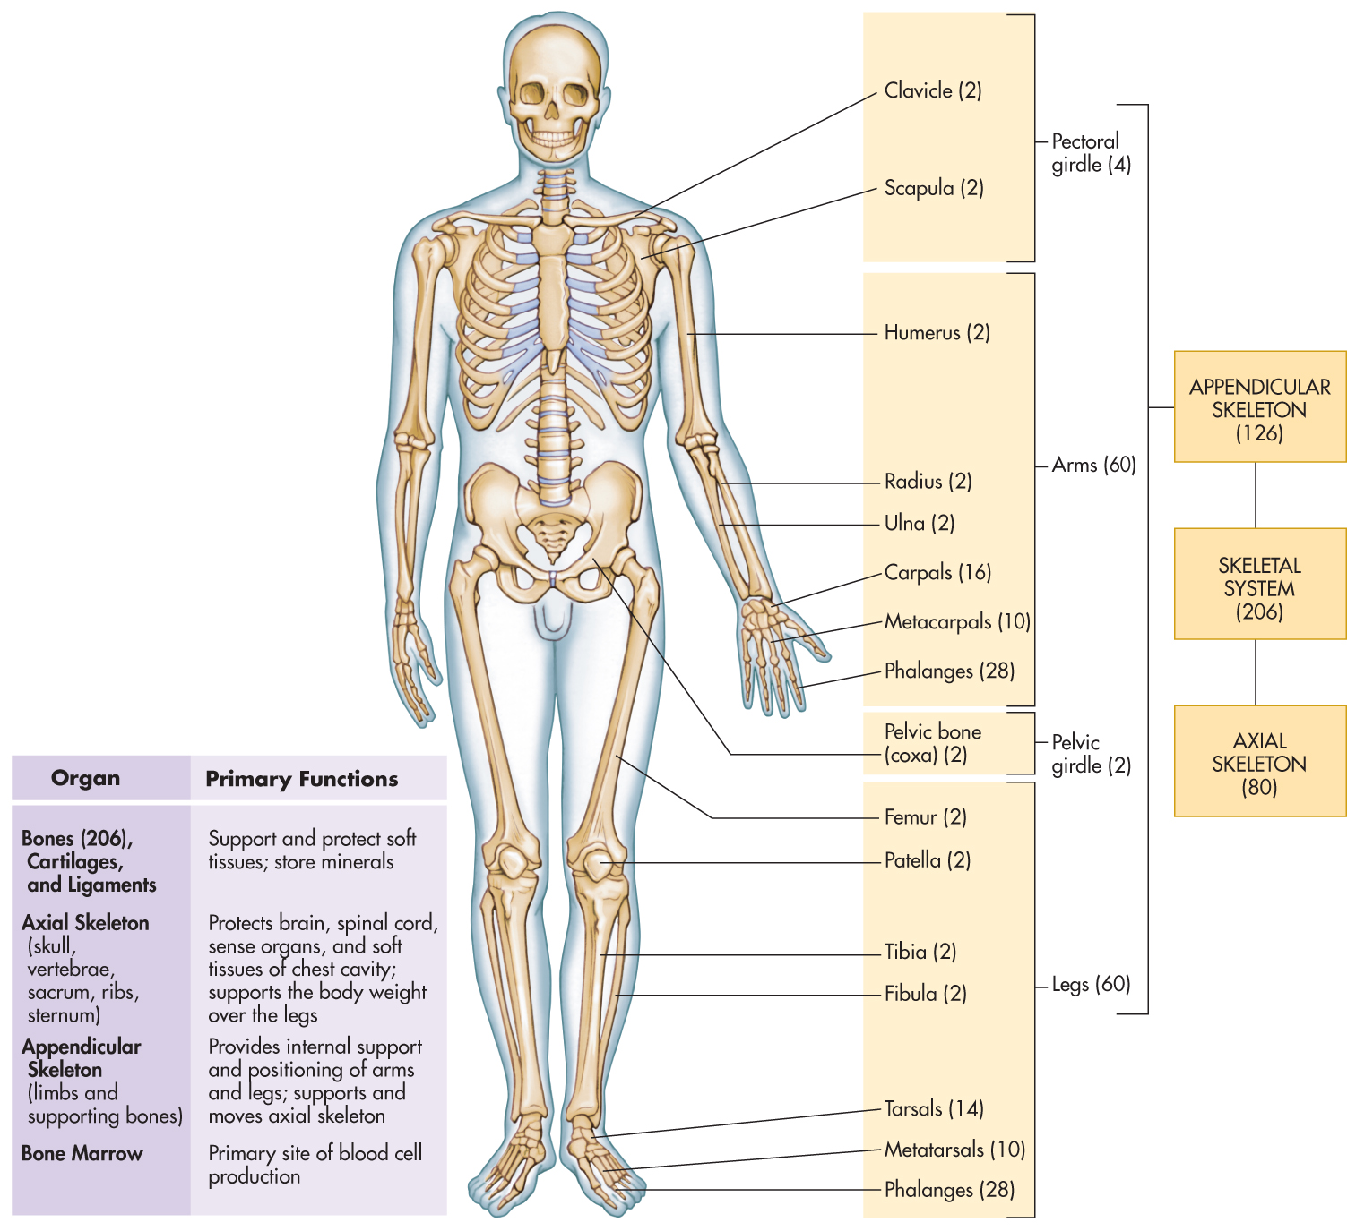
Figure 36-1 The skeletal system and its functions.

Slide 6
Osteoporosis
Bone mass is reduced enough to compromise normal functioning.
  Increased fractures
Occurs more in women
  Often in postmenopausal women
  Due to reduced estrogen
Osteopenia
  Bones become thinner and weaker during aging.
Can cause permanent disability if not arrested
continued on next slide

Slide 7
Osteoporosis
Agents Affecting Postmenopausal Osteoporosis
  New drugs being developed.
    Because estrogen and hormone replacement therapies have been linked to:
      Cardiovascular problems
      Cancer
  New agents
    Selective estrogen-receptor modulators (SERMs)
    New-generation bisphosphonates

Slide 8
Table 36-1 Drugs Used to Treat Osteoporosis
GENERIC NAME | TRADE NAME | AVERAGE ADULT DOSAGE | ROUTE OF ADMINISTRATION
Bisphosphonates
alendronate sodium | Fosamax | 5–10 mg/d 70 mg once a wk | PO
risedronate sodium | Actonel | 5 mg/d | PO
Hormonal Agents
calcitonin salmon | Calcimar, Miacalcin | 1 spray/d | Intranasal spray
raloxifene | Evista | 60 mg/d | PO
sodium fluoride | (Generic only) | In cycles | PO
PO, oral.

Slide 9
Osteoporosis
Agents Affecting Postmenopausal Osteoporosis
  Bisphosphonates
    Highly selective inhibitors of bone demineralization, resorption
      Appear to increase bone density
    Administered for:
      Osteoporosis
      Paget’s disease
      Hypercalcemia of
        Malignancy
        Postmenopausal osteoarthritis
continued on next slide

Slide 10
Osteoporosis
Agents Affecting Postmenopausal Osteoporosis
  Bisphosphonates
    Adverse effects
      Severe GI effects
        Flatulence
        Acid regurgitation
        Dysphagia
        Gastritis
      Headache
      Musculoskeletal pain
      Rash
continued on next slide

Slide 11
Osteoporosis
Agents Affecting Postmenopausal Osteoporosis
  Bisphosphonates
    Contraindications
      Hypersensitivity
      Severe renal impairment
      Hypocalcemia
      Lactation
      Pregnancy
    Interactions
      Calcium
      Food (especially dairy products)
continued on next slide

Slide 12
Osteoporosis
Agents Affecting Postmenopausal Osteoporosis
  Bisphosphonates
    Review correct administration with patients.
    Report fever accompanied by arthralgia and myalgia.
    Take 30 minutes before:
      Food
      Beverages
      Other medications
    Avoid breastfeeding.
continued on next slide

Slide 13
Osteoporosis
Agents Affecting Postmenopausal Osteoporosis
  Calcitonin
    Lowers serum calcium, phosphate levels
      By action on bones and kidneys
    Inhibits bone resorption
      Increasing bone density
    Administered for:
      Osteoporosis in postmenopausal women
      Hypercalcemia
      Symptomatic Paget’s disease
continued on next slide

Slide 14
Osteoporosis
Agents Affecting Postmenopausal Osteoporosis
  Calcitonin
    Adverse effects
      Headache
      Eye pain
      Hypersensitivity
      Urination frequency
      Chills
continued on next slide

Slide 15
Osteoporosis
Agents Affecting Postmenopausal Osteoporosis
  Calcitonin
    Adverse effects
      Chest pressure
      Weakness
      Dizziness
      Nasal congestion
      Shortness of breath
      Anaphylaxis (with human calcitonin only)
continued on next slide

Slide 16
Osteoporosis
Agents Affecting Postmenopausal Osteoporosis
  Calcitonin
    Contraindications
      Hypersensitivity
      Allergies
    Interactions
      Lithium
continued on next slide

Slide 17
Osteoporosis
Agents Affecting Postmenopausal Osteoporosis
  Calcitonin
    Report redness, warmth, or swelling at injection site.
    Check with physician before taking OTC preparations, such as:
      Supervitamins
      Hematinics
      Antacids
continued on next slide

Slide 18
Osteoporosis
Agents Affecting Postmenopausal Osteoporosis
  Raloxifene Hydrochloride
    Combines with estrogen receptors to:
      Decrease bone resorption
      Increase bone mass and density
    To prevent and treat osteoporosis
      Also to reduce risk of breast cancer
        In postmenopausal women
continued on next slide

Slide 19
Osteoporosis
Agents Affecting Postmenopausal Osteoporosis
  Raloxifene Hydrochloride
    Adverse effects
      Hot flashes
      Migraines
      Headache
      Flu-like symptoms
      Uterine disorders
continued on next slide

Slide 20
Osteoporosis
Agents Affecting Postmenopausal Osteoporosis
  Raloxifene Hydrochloride
    Adverse effects
      Vaginal bleeding
      Urinary tract disorders
      Breast pain
      Depression
      Insomnia
      Dizziness
continued on next slide

Slide 21
Osteoporosis
Agents Affecting Postmenopausal Osteoporosis
  Raloxifene Hydrochloride
    Contraindications
      Pregnancy or possible pregnancy
      Venous thromboembolic events
    Interactions
      Systemic estrogen replacement therapies
      Diazepam
      Lidocaine
      Diazoxide
      Cholestyramine
      Warfarin
continued on next slide

Slide 22
Osteoporosis
Agents Affecting Postmenopausal Osteoporosis
  Raloxifene Hydrochloride
    Report unexplained calf pain or tenderness.
    Avoid prolonged restriction of movement.
      During travel
    Inform patients about hot flashes.
    Avoid breastfeeding.
continued on next slide

Slide 23
Rheumatoid Arthritis
Systemic autoimmune disease
  Inflammation of joint-lining membranes
  Also affects internal organs
Occurs 2–3 times more often in women
  Onset usually at ages 40–60
  Affects:
    Hands
    Feet
    Wrists
    Spine
    Shoulders
    Ankles
    Hips
continued on next slide

Slide 24
Rheumatoid Arthritis
Antirheumatic Drugs
  Drugs with anti-inflammatory activity
    Agents of first choice
  Various agents include:
    Salicylates
    NSAIDs
    COX-2 inhibitors
    Corticosteroids
    DMARDs

Slide 25
Table 36-2 Disease-Modifying Drugs for Rheumatoid Arthritis
GENERIC NAME | TRADE NAME | AVERAGE ADULT DOSAGE | ROUTE OF ADMINISTRATION
Gold Compounds
auranofin | Ridaura | 3–6 mg/d; may increase up to 3 mg tid after 6 mo | PO
aurothioglucose | Solganal | 10–50 mg; initially, 10 mg and then increased weekly until 1 g is reached | IM
gold sodium thiomalate | Myochrysine | Dose may be continued at 25–50 mg every other wk for 2–20 wk | IM
tid, three times a day; PO, oral;. IM, intramuscular; SC, subcutaneous.
continued on next slide

Slide 26
Table 36-2 Disease-Modifying Drugs for Rheumatoid Arthritis
GENERIC NAME | TRADE NAME | AVERAGE ADULT DOSAGE | ROUTE OF ADMINISTRATION
Miscellaneous Agents
adalimumab | Humira | 40 mg every other wk (may use 40 mg/ wk if not on concomitant methotrexate) | SC
etanercept | Enbrel | 25 mg twice weekly or 0.08 mg/kg (or 50 mg) once weekly | SC
hydroxychloroquine sulfate | Plaquenil | 200–600 mg/d | PO
tid, three times a day; PO, oral;. IM, intramuscular; SC, subcutaneous.
continued on next slide

Slide 27
Table 36-2 Disease-Modifying Drugs for Rheumatoid Arthritis
GENERIC NAME | TRADE NAME | AVERAGE ADULT DOSAGE | ROUTE OF ADMINISTRATION
Miscellaneous Agents
methotrexate | Trexall | Single dose of 7.5 mg weekly, or divided doses of 2.5 mg q12h, for 3 doses, given once weekly | PO
sulfasalazine | Azulfidine | 250–500 mg/d (maximum: 8 g/d) | PO
tid, three times a day; PO, oral;. IM, intramuscular; SC, subcutaneous.

Slide 28
Rheumatoid Arthritis
Gold Compounds
  Not used frequently today due to toxicity
  Appear to suppress immune responses
  Administered for:
    Active RA
    When salicylates, other NSAIDs were not effective
continued on next slide

Slide 29
Rheumatoid Arthritis
Gold Compounds
  Adverse effects
    Hypersensitivity
    Syncope
    Bradycardia
    Tongue thickening
    Metallic taste
    Thrombocytopenia
    Leukopenia
    Aplastic anemia
continued on next slide

Slide 30
Rheumatoid Arthritis
Gold Compounds
  Contraindications
    Gold allergy
    Severe toxicity from heavy metals
    Diabetes mellitus
    Renal or hepatic insufficiency
    Hepatitis
continued on next slide

Slide 31
Rheumatoid Arthritis
Gold Compounds
  Interactions
    Antimalarials
    Immunosuppressants
    Penicillamine
    DMARDs
continued on next slide

Slide 32
Rheumatoid Arthritis
Gold Compounds
  Patients must report adverse effects.
  Report unusual color or odor of urine.
  Avoid contact with anyone who has:
    A cold
    Had a recent vaccination
    Been exposed to a communicable disease
continued on next slide

Slide 33
Rheumatoid Arthritis
Hydroxychloroquine
  Anti-infective, anti-malarial agent
  Approved for RA, but not as effective
    Often used for lupus erythematosus
  Adverse effects
    Fatigue
    Headache
    Mental or mood changes
    Anxiety
continued on next slide

Slide 34
Rheumatoid Arthritis
Hydroxychloroquine
  Adverse effects
    Retinopathy
    Blurred vision
    Difficulty focusing
    Anorexia
    Nausea, vomiting
    Diarrhea
    Abdominal cramps
continued on next slide

Slide 35
Rheumatoid Arthritis
Hydroxychloroquine
  Contraindication
    Hypersensitivity
  Interactions
    Antacids and laxatives containing aluminum or magnesium
    Rabies vaccine
continued on next slide

Slide 36
Rheumatoid Arthritis
Hydroxychloroquine
  Follow drug regimen exactly as prescribed.
  Keep drug out of reach of children.
  Patients need regular eye exams.
  Avoid breastfeeding.
continued on next slide

Slide 37
Rheumatoid Arthritis
Methotrexate
  Affects lymphocyte, macrophage function
  Administered for:
    Severe psoriasis
    Psoriatic arthritis
    Rheumatoid arthritis
    To maintain remission in neoplastic disease
continued on next slide

Slide 38
Rheumatoid Arthritis
Methotrexate
  Adverse effects
    Dose-related bone marrow suppression
    Infertility with azoospermia
    Amenorrhea
  Contraindications
    Pregnancy
    Blood dyscrasias
    Lactation
    Of childbearing age
    Hepatic and renal insufficiency
continued on next slide

Slide 39
Rheumatoid Arthritis
Methotrexate
  Interactions
    Alcohol
    Azathioprine
    Sulfasalazine
    Chloramphenicol
    Sulfonamides
continued on next slide

Slide 40
Rheumatoid Arthritis
Methotrexate
  Interactions
    Salicylates
    NSAIDs
    Phenytoin
    Tetracyclines
    Probenecid
continued on next slide

Slide 41
Rheumatoid Arthritis
Methotrexate
  Advise patients of its dangers.
    Explain the symptoms to be immediately reported.
  Avoid alcohol.
  Avoid sunlight and UV light.
    Wear sunglasses.
continued on next slide

Slide 42
Rheumatoid Arthritis
Sulfasalazine
  Locally acting
    May exert an anti-inflammatory effect
  Administered for:
    Rheumatoid arthritis
    Juvenile chronic arthritis
    Ankylosing spondylitis
continued on next slide

Slide 43
Rheumatoid Arthritis
Sulfasalazine
  Adverse effects
    Toxicity
    Nausea and vomiting
    Headache
    Rash
    Anemia
    Oligospermia
    Blood dyscrasias
    Liver injury
    Allergic reactions
continued on next slide

Slide 44
Rheumatoid Arthritis
Sulfasalazine
  Contraindications
    Hypersensitivity
    Agranulocytosis
    Intestinal and urinary tract obstruction
    Porphyria
    Pregnancy
    Children under age 2
continued on next slide

Slide 45
Rheumatoid Arthritis
Sulfasalazine
  Interactions
    Antibiotics
  Urine and skin may turn orange-yellow.
  No breastfeeding until physician approves.

Slide 46
Gout and Gouty Arthritis
Crystal deposits in and around joint spaces
  Then acute inflammation of joint
Commonly affects men after age 50
Three manifestations:
  Hyperuricemia
  Acute gouty arthritis
  Chronic gouty arthritis

Slide 47
Table 36-3 Antigout Medications
GENERIC NAME | TRADE NAME | AVERAGE ADULT DOSAGE | ROUTE OF ADMINISTRATION
allopurinol | Aloprim, Zyloprim | 200–800 mg/d | PO, IV
colchicine | Colchicine | 0.5–0.6 mg/d prophylactically; 0.5–1.2 mg q1–2h for acute attack | PO
probenecid | Benemid | 250–500 mg bid | PO
sulfinpyrazone | Anturane | 100–400 mg/d | PO
PO, oral; IV, intravenous; bid, twice a day.

Slide 48
Gout and Gouty Arthritis
Antigout Drugs
  Colchicine
    Anti-inflammatory agent
      Inhibits formation of white blood cells
    Used only for:
      Acute gouty attacks
      To reduce attacks in chronic gout
continued on next slide

Slide 49
Gout and Gouty Arthritis
Antigout Drugs
  Colchicine
    Adverse effects
      Nausea and vomiting
      Diarrhea
      Abdominal pain
      Decreased absorption of vitamin B₁₂
continued on next slide

Slide 50
Gout and Gouty Arthritis
Antigout Drugs
  Colchicine
    Contraindications
      Blood dyscrasias
      Severe GI, renal, or hepatic conditions
      Severe cardiac disease
      Subcutaneous or intramuscular use
      Pregnancy
    Interactions
      None listed
continued on next slide

Slide 51
Gout and Gouty Arthritis
Antigout Drugs
  Colchicine
    Stop taking, and report symptoms to physician:
      GI symptoms
      Signs of bone marrow depression
    Keep drug available at all times for acute attacks.
    Avoid alcohol.
    Avoid breastfeeding without consulting physician.
continued on next slide

Slide 52
Gout and Gouty Arthritis
Antigout Drugs
  Allopurinol
    Improves solubility of uric acid
    No analgesic, anti-inflammatory, or uricosuric actions
    Used to control chronic, not acute gout
    Adverse effects
      Drowsiness
      Headache
      Dizziness
      Nausea, vomiting
      Diarrhea
continued on next slide

Slide 53
Gout and Gouty Arthritis
Antigout Drugs
  Allopurinol
    Adverse effects
      Abdominal pain
      Hepatotoxicity
      Renal insufficiency
      Itching
      Rash
continued on next slide

Slide 54
Gout and Gouty Arthritis
Antigout Drugs
  Allopurinol
    Contraindications
      Hypersensitivity
      As initial treatment for acute attacks
      In most children
continued on next slide

Slide 55
Gout and Gouty Arthritis
Antigout Drugs
  Allopurinol
    Interactions
      Alcohol
      Caffeine
      Thiazide diuretics
      Ampicillin
      Amoxicillin
      Warfarin
continued on next slide

Slide 56
Gout and Gouty Arthritis
Antigout Drugs
  Allopurinol
    Patients must drink 3 quarts of fluid per day.
    Report
      Diminishing urine output
      Cloudy urine
      Unusual urine color or odor
      Pain or discomfort during urination
      Itching
      Rash
    Avoid driving.
    Avoid sun exposure.
continued on next slide

Slide 57
Gout and Gouty Arthritis
Antigout Drugs
  Uricosuric Agents
    Competitively inhibit renal tubular reabsorption of uric acid
      To promote its excretion
    For severe attacks of gout
    Adverse effects
      GI irritation
      Allergic dermatitis
      Nephrotic syndrome
continued on next slide

Slide 58
Gout and Gouty Arthritis
Antigout Drugs
  Uricosuric Agents
    Contraindications
      Blood dyscrasias
      Uric acid kidney stones
    Interactions
      Salicylates
      Probenecid
continued on next slide

Slide 59
Gout and Gouty Arthritis
Antigout Drugs
  Uricosuric Agents
    Patients must drink 3 quarts of fluid per day.
    Restrict intake of high-purine foods.
      Organ meats
      Meat soups
      Gravy
    Unless physician is consulted:
      Do not stop treatment
      Do not take aspirin or OTC medications

Slide 60
Muscle Spasms and Pain
Often associated with
  Traumatic injuries and spasticity from:
    Cerebral palsy
    Stroke
    Head and spinal cord injuries
Two types of spasms
  Tonic
    Single, prolonged
  Clonic
    Multiple, rapidly repeated
continued on next slide

Slide 61
Muscle Spasms and Pain
Skeletal Muscle Relaxants
  Spasticity results from increased muscle tone
    Caused by hyperexcitable neurons or a lack of inhibition in the spinal cord
  Block somatic motor nerve impulses
    Through depression of specific neurons in the CNS
continued on next slide

Slide 62
Muscle Spasms and Pain
Skeletal Muscle Relaxants
  Spasticity results from increased muscle tone
    Caused by hyperexcitable neurons or a lack of inhibition in the spinal cord
  Block somatic motor nerve impulses
    Through depression of specific neurons in the CNS
continued on next slide

Slide 63
Muscle Spasms and Pain
Skeletal Muscle Relaxants
  Centrally Acting Muscle Relaxants
    May affect brain or spinal cord
      To inhibit upper motor neuron activity
    Administered for local spasms to reduce pain and increase range of motion
    Baclofen often drug of first choice
      Due to wide safety margin
continued on next slide

Slide 64
Muscle Spasms and Pain
Skeletal Muscle Relaxants
  Centrally Acting Muscle Relaxants
    Adverse effects
      Sedation
      Drowsiness
      Dizziness
      Weakness
      Fatigue
      Hallucinations
      Ataxia
continued on next slide

Slide 65
Muscle Spasms and Pain
Skeletal Muscle Relaxants
  Centrally Acting Muscle Relaxants
    Contraindications
      Bacteremia
      Clotting disorders
      Porphyria
      Children under age 5
      Liver disease
      Glaucoma
      Pregnancy
      Lactation
continued on next slide

Slide 66
Muscle Spasms and Pain
Skeletal Muscle Relaxants
  Centrally Acting Muscle Relaxants
    Interactions
      Alcohol
      Other CNS depressants
      MAOIs
      Antihistamines
      Sulfonylureas
      Insulin
continued on next slide

Slide 67
Muscle Spasms and Pain
Skeletal Muscle Relaxants
  Centrally Acting Muscle Relaxants
    Avoid alcohol and CNS depressants.
    Diabetics must closely monitor blood glucose.
    Avoid driving and using heavy machinery.
      Until effect is stabilized
continued on next slide

Slide 68
Muscle Spasms and Pain
Skeletal Muscle Relaxants
  Centrally Acting Muscle Relaxants
    Report all adverse reactions.
    Avoid unapproved OTC drugs.
    Do not stop medication abruptly.
    Avoid during pregnancy and breastfeeding.

Slide 69
Table 36-4 Centrally Acting Muscle Relaxants
GENERIC NAME | TRADE NAME | AVERAGE ADULT DOSAGE | ROUTE OF ADMINISTRATION
baclofen | Baclofen | 15–80 mg/d in divided doses | PO
carisoprodol | Soma | 350 mg tid–qid | PO
chlorzoxazone | Parafon Forte | 250–750 mg tid–qid | PO
clonazepam | Klonopin | 0.5–20 mg tid | PO
cyclobenzaprine | Flexeril | 10–60 mg/d in divided doses | PO
dantrolene | Dantrium | Initially, 25 mg/d and then 50–400 mg/d in divided doses | PO
PO, oral; tid, three times a day; qid, four times a day; bid, twice a day; IM, intramuscular; IV, intravenous.
continued on next slide

Slide 70
Table 36-4 Centrally Acting Muscle Relaxants
GENERIC NAME | TRADE NAME | AVERAGE ADULT DOSAGE | ROUTE OF ADMINISTRATION
diazepam | Valium | 2–10 mg bid–qid 2–10 mg | PO IM, IV
lorazepam | Ativan | 1–10 mg bid–tid | PO
methocarbamol | Robaxin | 1.5 g qid for 2–3 d and then 4–4.5 g/d in 3–6 divided doses 0.5–1 g q8h 1–3 g/d in divided doses (max- imum: rate of 300 mg/min) | PO IM IV
orphenadrine citrate | Norflex | 100 mg bid 60 mg bid | PO IM, IV
PO, oral; tid, three times a day; qid, four times a day; bid, twice a day; IM, intramuscular; IV, intravenous.

